Slide 1
Business Case Development
Presented By
Mansi Padhiyar (0901509)
Jenab Vohra (0904905)
Jay Mangnani (0904910)
Nihal Gupta (0959636)
Kalyan Chintaguntla (0906298)
Submitted To
Prof. Nancy Engelhardt
Notes:
Hi Nancy
I am Mansi Padhiyar , Me and my team is going to present a business case for “Good For You” restaurant to expand their business.

Slide 2
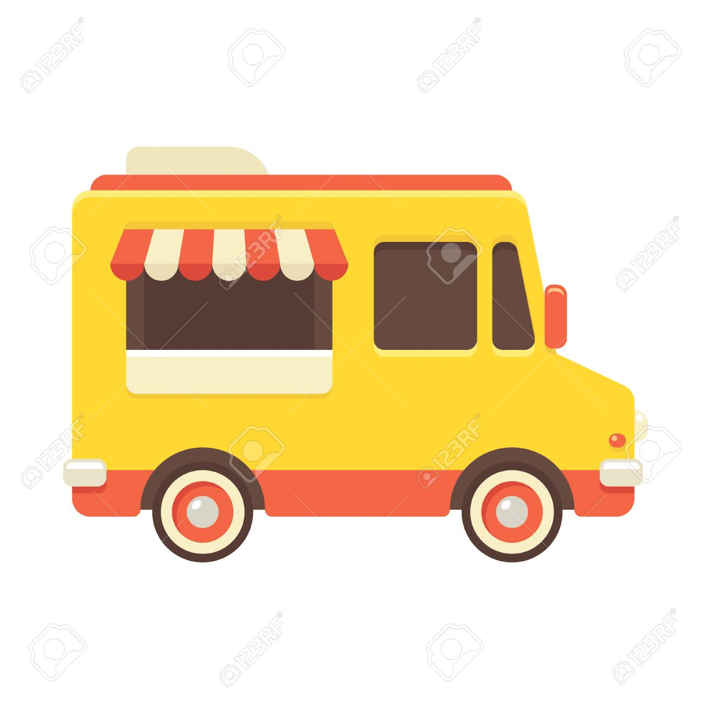
“GOOD FOR YOU”
Good For You
Food Truck Business – Taste on Wheels
Notes:
Company Background: Good for You is a fast-food restaurant. They have a single dine-in restaurant at London, which is located south of city. They have food-menu item for all type of age group people but not well recognized restaurant in locality because of remote location. There speciality is in Indian spices food. The company is in loss for a while because though they have cheap menu and good quality of food , people don’t want to show up to that location as it is far from city. Some of the people are not aware about this restaurant ,as it is not in city. So here comes , the solution to this problem. The implementation of the taste on wheels. If people cannot go to food but food can be with the people nearby . So our idea to the problem is implementation of food truck.

Slide 3
Table of Contents
Alternatives
Risk, Mitigation Plan
2-3 alternatives
Objectives
Metrics
Cost Benefit Analysis
Recommendation
and
Rationale
accountabilities
Milestones
Benefits
Resources
02
03
05
04
Project Plan
Opportunity Statement
Benefits
Importance of opportunities
01
Taste on the Wheels
06
Notes:
The flow of presentation will be first Opportunity statement, then a list of options of expanding business followed by Cost and benefit analysis of all the alternatives. Lastly, our final recommendations with its risk register and its mitigation plan. Finally the high level project plan.

Slide 4

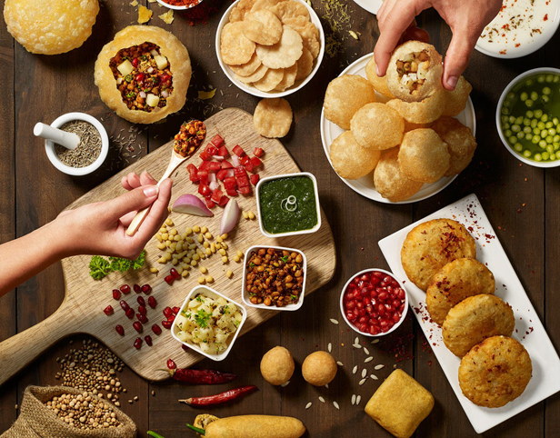
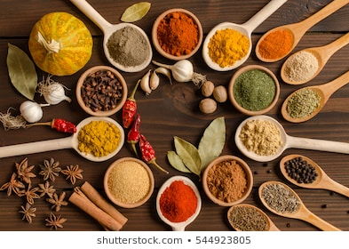
O
pportunity
Statement
Spreading an Indian Aroma on wheels by adding street food as main course to the Indian cuisine lovers, enrich with different spices and delicious dishes serve to people and reach to maximum customer satisfaction by serving best services which is “Good For You”
Indian Cuisine Lovers
Customer Satisfaction
Street food enriched with different spices
Notes:
The business is currently new in London city , we don’t find many food trucks in here and especially Indian cuisine , so we think that is the great opportunity to get company out of loss and can leave its trademark with tasty and quality food.
The opportunity statement is like this:
Spreading an Indian Aroma on wheels by adding street food as main course to the Indian cuisine lovers, enrich with different spices and delicious dishes serve to people and reach to maximum customer satisfaction by serving best services which is “Good For You”
Our main motive is
1) To get Indian cuisine lovers a good taste and quality food
2)Customer satisfaction
3)Getting street food to new level.
Further will be taken over by Jenab

Slide 5

Objectives
Metrics
Alternative 1
Merger and Acquisition
To reduce risk
Generating revenue by overtaking small business
Expanding market share by acquiring customer base of subsidiaries
Increase internal competition among employees which will increase productivity
Employee statistics for good customer services
Operational metrices: Less initial investment
Business Metrices: ROI and profit sharing
Business units are transferred or consolidated with other entities
Notes:
Jenab Speaking:
So as we have great opportunity , we need to think about how we will get this food truck on roll
So we got three alternatives that can be the best for introducing new food truck.
1)Merger and Acquisition 2)Marketing and Advertisement 3)Sole Proprietorship
Here I am going to talk brief about Merger and Acquisition
Merger and Acquisition can be a strong alternative. The company is in loss that can be taken over or offer a partnership with certain amount of ratio. The both terms has wide meaning but when combined can-do lot better than what the individual companies are on their current state.
Objectives:
By using Merger and Acquisition, it will reduce the risk and narrow down to one (food truck) which will prove fruitful result.
The revenue can be generated by overtaking the company and understand the requirements and to fair prices.
A part of merger and acquisition the ideas and skills that are good in individual company can be merged and can increase the profit which leads to good sharing of the profit. This also helps in purchasing market share.
M&A can increase the internal competition and gets to good wages according to their work.
Metrics
Employee statistic is playing major role because the employee are the face of the company and offers good customer service.
Operational statistic will relate to the free business because of already having food truck and no additional costs for licensing, certificate & truck.
Business Statistic is the important lead in the graph of M&A as it depends directly to the profit sharing and the ROI.

Slide 6

Spread awareness of food product among customer
Increase Brand value
Increase customer advocacy
Total increase in followers on social media
Increase in number of likes, comments, repost of our food menu
Hashtag count of brand name on social media
Increase in sales value post marketing
Objectives
Metrics
Alternative 2
Marketing and Advertisement
Increases brand value
Notes:
The second option we thought is Marketing and Advertisement , which will be introducing new strategies how to promote new business.
There is growing competition in the market among the restaurants fierce, so every business needs an effective strategy to develop. As per the research, success of restaurant business is beyond cooking the most palatable dishes however somehow depends on its planned marketing strategies. The assortment of marketing strategy should be top-notch. By increasing the social media presence, the marketing will increase. There should be balance between marketing and advertisement that increases the brand value.
Objectives:
1)Marketing will help in establishing our food product in the restaurant business. It will spread awareness about our product to people.
2)Increase the brand value of the restaurant.
3)Increase customer advocacy. Our existing customers can help in introducing our product to their network.
Evaluation Metrics:
Total numbers of followers on social media. More followers mean a greater number of people know about our latest food items and are aware of our latest promotions and offers. This will increase our brand.
A total number of likes, comments on our dishes are counted weekly and monthly to check which food product is liked most by customers.
Hashtag count of our brand name on social media.
Increase in sales value post-marketing and advertisement for our restaurant.

Slide 7
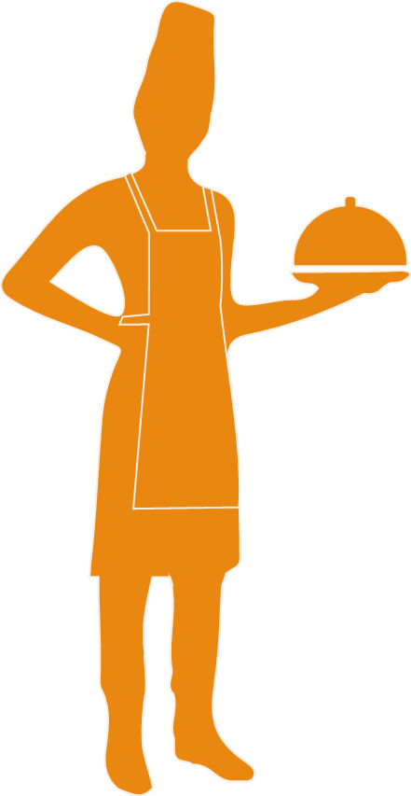
Return on Investment
Profit and loss
Less operating cost
Objectives
Metrics
Alternative 3
Sole Proprietorship
To maximise profit
To make quick decision for business
Increases brand value
Notes:
The third option is sole proprietorship , which is simple but needs high investment at very beginning of the project.
Sole proprietorship is the simplest form of any business where one can operate a business. The owner can instantly establish, and it is cost effective. So, giving the brand value to the food truck can increase its business. On the other hand, as the team we develop the business on our own and not take any company as our support and develop own. So, we will not need much formalities and may mix their business freely.
Objectives:
As a sole proprietor one can make his own menu and prices according to the market and his business.
Creating social media attractions and reduced price for the first month will be a good deal at start. This decision can be easily made because he is the only owner.
Metrics
Return on investment are the primary objective or expectations every company has and that return on investment is calculated by sales. These sales are calculated for every day, week, month and even they are calculated for quarterly and for a year.
The profit and loss from the food is entirely handled by the only owner because it comes under sole proprietorship.
Every operational cost is handled by the owner, so there can be mental pressure and performance pressure on one.
Further will be taken over by Jay.

Slide 8

Cost Benefit Analysis
Merger and Acquisition
Advertisement and Marketing
Sole Proprietorship
Cost and Benefits Ratio
3.81%
Net Present Value
$166,535
Pay Back Period
3 years
Return On Investment
1.18%
Internal Return Rate
54.69%
Cost and Benefits Ratio
1.56%
Net Present Value
$52,102
Pay Back Period
5 years
Return On Investment
1.22%
Internal Return Rate
16.75%
Cost and Benefits Ratio
2.54%
Net Present Value
$142,512
Pay Back Period
4 years
Return On Investment
1.15%
Internal Return Rate
20.35%
Notes:
Jay Speaking:
So now I am going to talk about some statistic we gather around.
Based on data gathered from a trusted source and taking precise estimate of operating cost and revenue, we calculated CBR,NPV, ROI and IRR of all three alternative. CBR is high for Merger and Acquisition because of less operating cost among all other alternative. Less operating cost and investment pushed NPV value at $166,535 of Merger and Acquisition. ROI of Advertisement and Marketing is higher but NPV value is very less compare to all.

Slide 9
Intangible Benefits
Merger and Acquisition
Advertisement and Marketing
Sole Proprietorship
Customer Satisfaction
Good Will
Employee Productivity
Innovation
Public Relation
Public Relations
Good Will
Innovation
Customer Satisfaction
Employee Productivity
Customer Satisfaction
Good Will
Employee Productivity
Innovation
Public Relation
Notes:
All three alternatives are also evaluated considering intangible benefits. These benefits are ranked based on higher value of weight obtained from multiple object analysis.
They were divided on basis of major distribution of people falling I different categories. The multiple objective analysis was calculated on this terms by assign some values and the very first one of all the alternatives that is customer satisfaction , public relation and again customer satisfaction are our results.

Slide 10
Recommendation: Merger and Acquisition
Less Capital Investment : $ 36,960
Initial Investment is distributed, so less capital investment .
01
High CBR : 3.48
Because of having experienced staff, time and money will be less spent.
02
Payback time : 3 years
Establishing food truck initially will be costly but it will allow to increase value of new entity on the third year
03
Third party vendor for Legal service
Legal services are done by other parties in acquisition
Shared loss and Benefits
If there is any loss, it can be divided
04
05
Notes:
We have chosen MERGER AND ACQUISTION as our final recommendation and reasons are as follow:
Though the initial investment of Marketing and Advertising is very less comparative than Merger & Acquisition, but it will apply after the food truck is established.
Experienced staff already, money and time is less spent compare to sole proprietorship
Establishing food truck initially will be costly but it will allow to increase value of new entity on the third year and helps in cost savings.
4. Legal services are already done by other party in acquisition, so much less time and money spent on it.
5 . If there is any loss, it is not only on one party, it can be divided.
Further will be taken over by Nihal

Slide 11
SWOT Analysis
S
W
O
T
S
W
O
T
STRENGTHS
WEAKNESS
OPPORTUNITIES
THREATS
experienced food truck staff
Brand recognition
Prices are cheaper
Innovative business in London city
Limited funds available
No fine- dine facility
Costs rising due to increases in food costs
.
New emerging food truck market
Collaboration with a restaurant
Indian Cuisine lovers
reexamining current legislation restrictions on food truck
Weather condition
Fear of business loss
Notes:
Nihal Speaking:
Now I am going to talk in brief about SWOT analysis of the project.
Strength: experienced food truck staff, Brand recognition, Prices are cheaper ,Innovative business in London city
Weakness :Limited funds available, No fine- dine facility, Costs rising due to increases in food costs
Opportunities: New emerging food truck market, Collaboration with a restaurant, Indian Cuisine lovers
Threats: reexamining current legislation restrictions on food truck, Weather condition, Fear of business loss

Slide 12
Risk and Mitigation Plan
100%
40%
100%
40%
20%
Operator Risk/ Working hazards
Insufficient power and water supply
Workers compensation insurance
Safety equipment's
Proper training .
Food Wastage
Store water in truck
Purchase generator
Get permission from authorities for power and water supply
Fire Hazard
Changes in Licensing
Property damage insurance
Regular inspection
Proper maintenance
Regular checking of expiry dates on food packages
Keeping inventory in balance
Track on demand and supply
Plan for legal work in advance
Adapt new framework
Notes:
In every business there are risks so here are some risks we found for Merger and Acquisition alternative of introducing new food truck. The risk are as follow with its mitigation strategies and showing probability of that risk.
Fire Hazard – It has 100% chances because of carelessness and to avoid this risk its mitigation strategy would be that ,we can take Property damage insurance which protects the property from collision, theft, fire and other damages while vehicle is parked. Also, regular inspection, proper maintenance such as cleaning the grease every time after cooking, making sure no fuel or lighter near to the gas can avoid this risk.
Operator Risk/Working Hazard – There are 100% chances due to fatigue, carelessness or lack of training, to prevent it such accidents proper safety equipment such as gloves and anti slip shoes is necessary. Proper training is also must. Workers Compensation insurance is mandatory.
Food Contamination/ Wastages – Has 40% chance in case of bad weather and less crowded day. We will be avoiding wastages by regularly checking the expiry date of packed food items and keeping demand and supply of inventory in balance.
Insufficient power and water supply – there are 40% chances if employees don’t follow the daily work schedule and to avoid this risk, we can store enough water inside the truck. We can purchase the generator in case of power cut. We can also get the permission from the authorities to use electricity and water supply.
Sudden changes in licensing framework that resulted from political or economic changes has 20% Chances in case employer is not following the business news, trends or forgot to process for permits and this can be avoided by planning permits and other legal work in advance.

Slide 13
Milestone After Business Setup
Meet breakeven and expand the business
meet the payback period and grow the business by adding new truck on another location
04
Adding new dishes
Evaluate option for additional dishes on the menu as per the customer preferences
03
Hiring experienced staff
Add a part-time employee and increase hours until part-time position becomes a full-time one
02
Establish food truck business
Securing financing, seed capital, merger and acquisition
01
Notes:
The project is not completed without the milestone added , so here are the Milestone after food truck is rolling on the roads of London
We have figure out four milestone for it.
Step 1 :
Establish entity – food truck establishment will be done by securing financing , by merger and acquisition and having seed capital. After having enough fund, we will be ready to do campaigning for starting of new business.
Step 2:
Hiring experienced staff - Add a part-time employee and increase hours until part-time position becomes a full-time one and this way it will be decreasing the hours of the owners on the truck
Step 3
Adding new dishes – Evaluate option for different and new dishes on the menu as per the customer preferences by doing survey. Also, find the opportunity to expand the business
Step 4
Meet breakeven and expand the business – once we will be able to know the customer demand , we can meet the payback period and ultimately, we can grow business by adding new truck on another location.

Slide 14
Stakeholders list (Accountabilities)
Role: Supplier
Bonding with the owner
Supplying all the essentials to serve the need
Role: License agent
Role: Consumer
Responsible for truck licensing.
Parking fees and issues.
Giving review
Increasing profit
.
Owners
Customer
employees
Suppliers
Competitors
Licensing agents
Role: Partners
Role: Performer (ambassador)
Role: Competitors
relation with other owners
collaborative nature
.
Other truck vendors are the competitors
They will have an impact on the profits of our food truck.
involve in daily activities
improve skills and perform well
pay attention to the customer satisfaction
Notes:
The stakeholders are the important role in any project. The stakeholder which are important to our business are listed below:
1. Owners will be playing the role of partners and they will be responsible for bonding with the other owners and have collaborative nature and offering time and money equally
2. Customer are paying the role of consumer who will give the review and feedback on the services they have received and on the food. They are the one who will help to increase the profit
Employees are the performer of the company who are responsible for improving their skills, get involve in daily activities and maintain the equality for both companies by managing the due diligence process
3. Suppliers are accountable for suppling all the essentials to serve the need and bonding with the owner
4. Competitors will access the business and make sure they attract people; they will also impact on profit of food truck business.
5. License agent has responsibility of granting the permission for parking , food truck licensing and other legal issues.
6. Other – there are others stakeholder who are playing the role of marketing , collaborators and the decision makers.
Further will be taken over by Kalyan

Slide 15
Project Plan
Finishing
Actions
Details Analysis
Inventory control
Project Kickoff
Planning and Monitoring
Reviewing options
Notes:
Kalyan Speaking:
The flow of the project can be like as follow:
Project kick off will include kick off meeting and team building meeting where team will meet with other members. This meeting will help to know the strengths and weakness of each other.
In Reviewing option, innovation meeting and process check meeting will help to see how team is working with the new market trend
In detail analysis phase, research and analysis meeting , planning meeting will be held to represent 2-3 alternatives of solutions with detail analysis and designing of project .
Planning and monitoring phase will have implementation meeting where team will plan to execute the solution and again process check meeting will be done to check the work so far.
Actions - In this phase, required actions will be taken over previous alternatives by multiple objective analysis, sensitivity analysis and risk register
Inventory and control will have production meeting which will be on gathering of equipment with external supplies cost and budgeting. Moreover, problem solving meeting will help to remove the obstacles so far in the project.
Finishing – This last phase will complete with broadcast meeting and training meeting which will be on final check of implementation plan, employee trainings , checklist document and than it is ready to start to roll out.

Slide 16
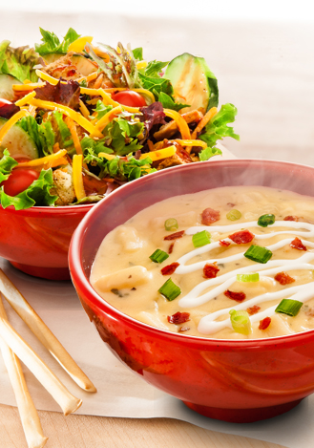
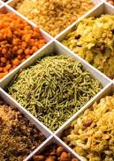
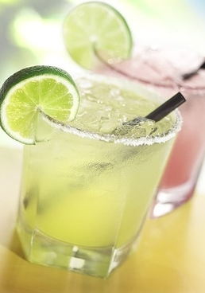
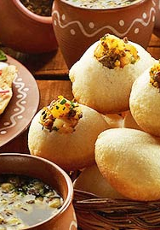
Good For You
Menu
Soft Drinks
Indian Food Specialites
Soups &Salads
Snacks
Notes:
The menu for our food truck is :
1)SOUPS & SALADS 2)SNACKS 3)SOFT DRINKS 4)INDIAN FOOD SPECIALITIES.

Slide 17
Good For You
Thank you
Notes:
Lastly we Thanking you Prof Nancy for giving us opportunity for presenting our business case and guiding us through out our journey.

